Slide 1
Matthew Morley
12/1/2023

Slide 2
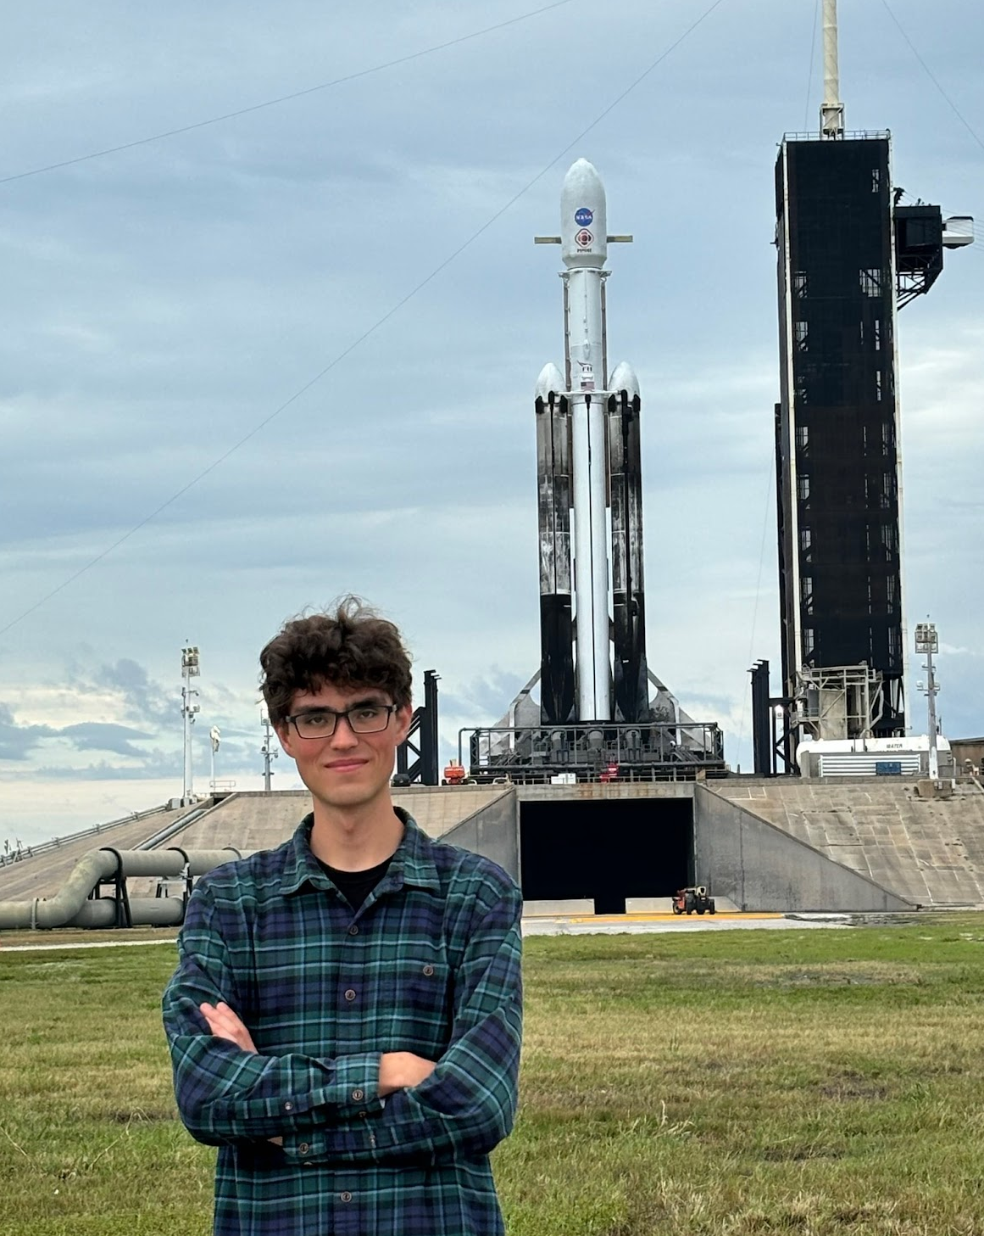
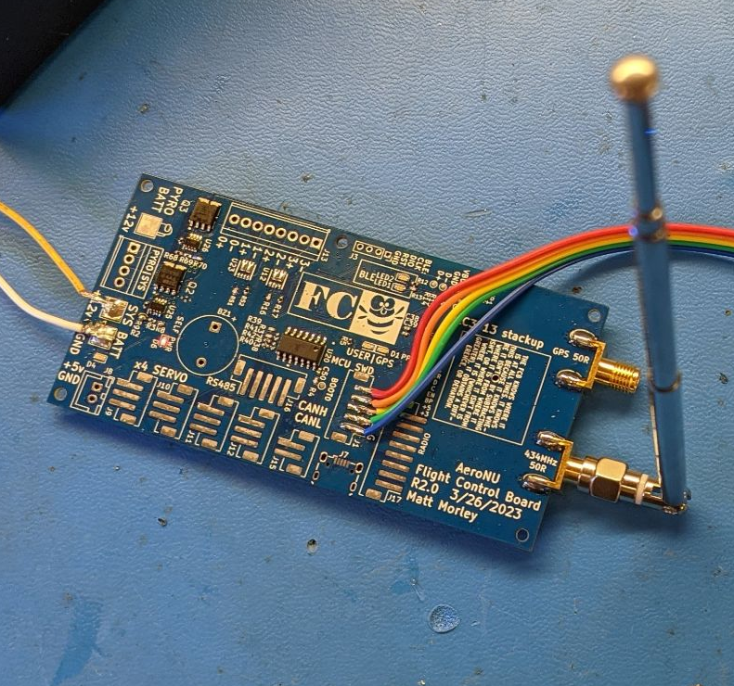
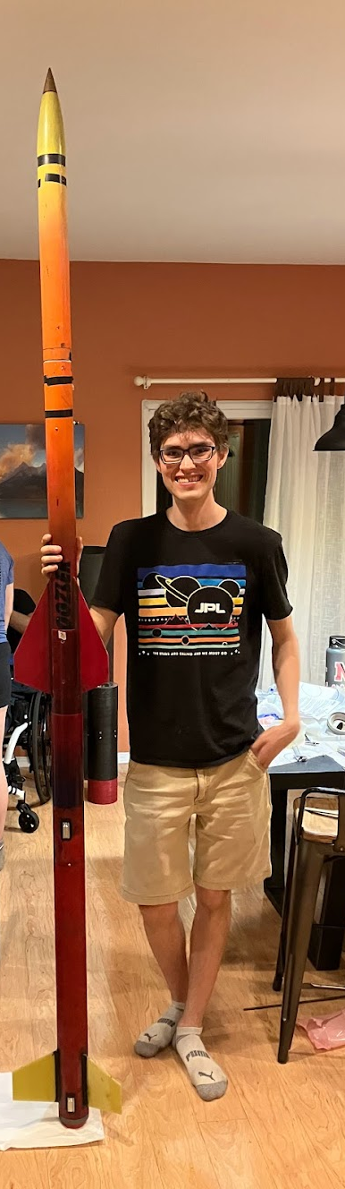
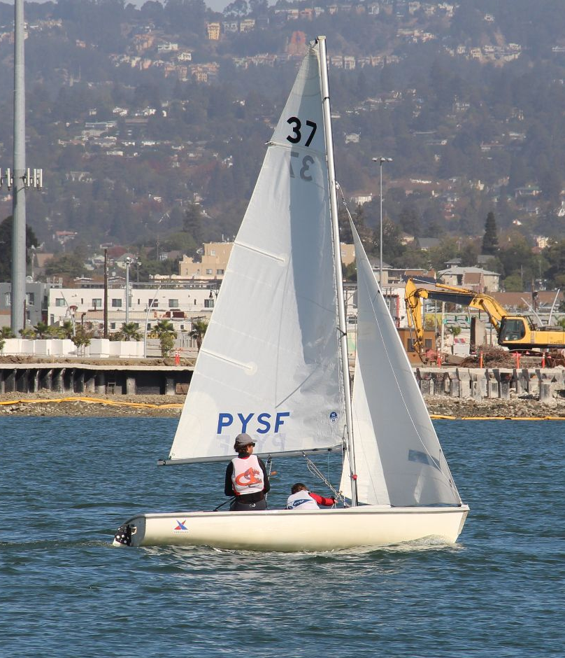
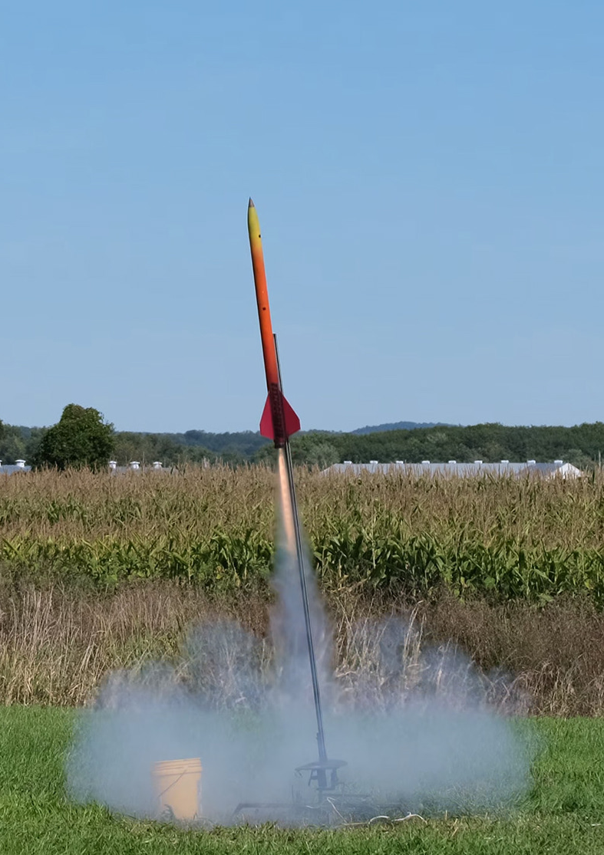
Who am I?
BSME, Northeastern (2024)
Avionics Lead (AerospaceNU)
Past experience
Engineering Intern, SpaceX
JPL SIP, 347F Robotic Mobility
Software/Robotics & Controls, J&J
Avionics @ GreenSight Agronomics
Outside work
Sailing, model rocketry, rock climbing, HAM Technician (KM6GNL)

Slide 3
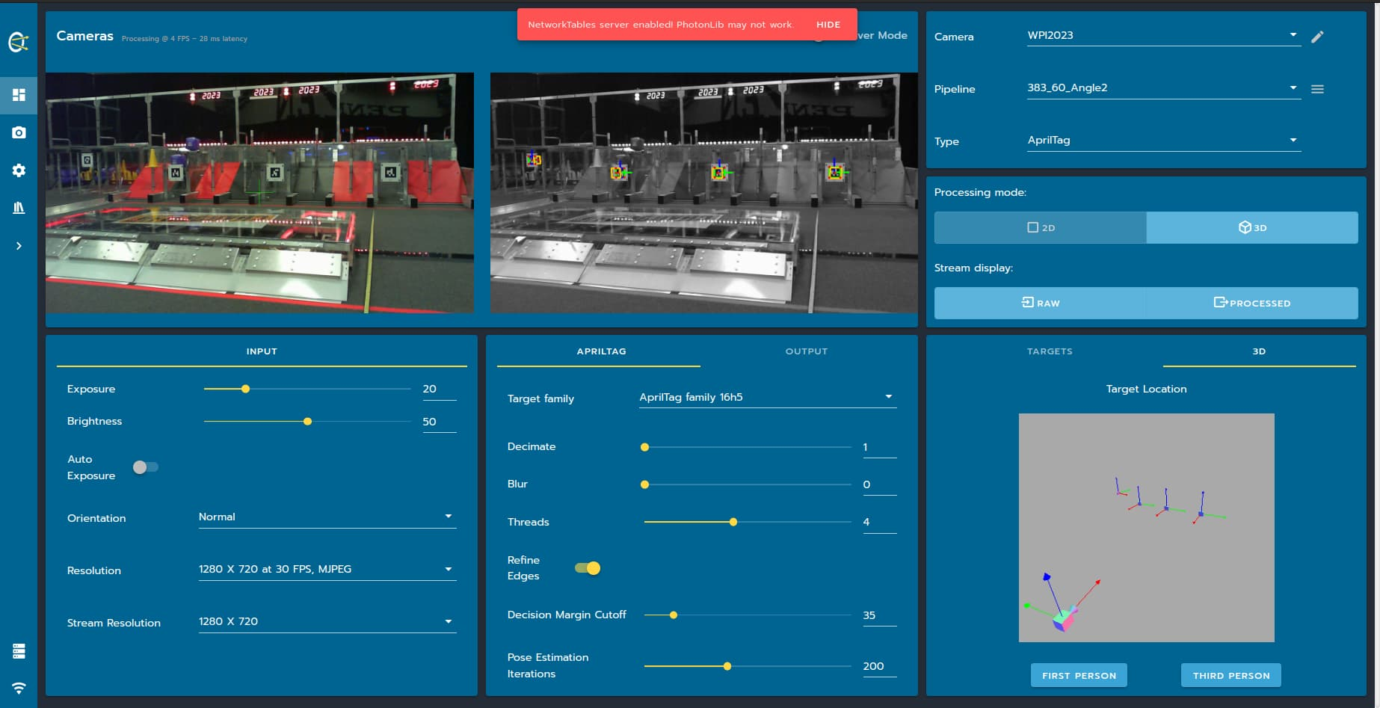
PhotonVision (2020-ongoing)
OSS vision for FIRST Robotics Competition teams
15,000+ downloads
Embedded Linux experience
CSI Camera + GPU processing (Libcamera)
Networking
Building SW infrastructure for success
CI, automation, dependency management
FIRST Mentor Conference talk
Notes:
One of my SW passion projects/things I do for fun/thing that’s grown a life of its own
Grew out of high school robotics project
Great learning experience for wide range of critical software skills

Slide 4
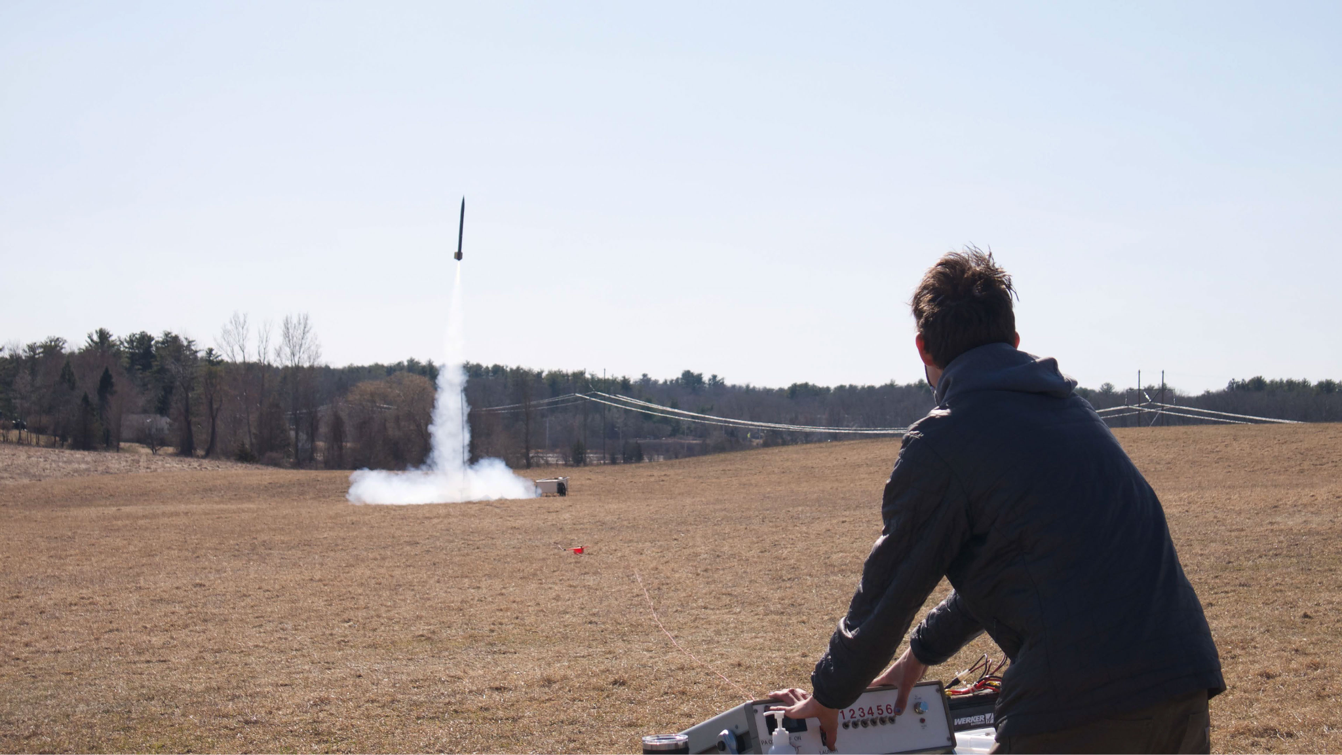
AerospaceNU & Rocket Code
Matt presses the big red button
Notes:
Matt presses the big red button

Slide 5
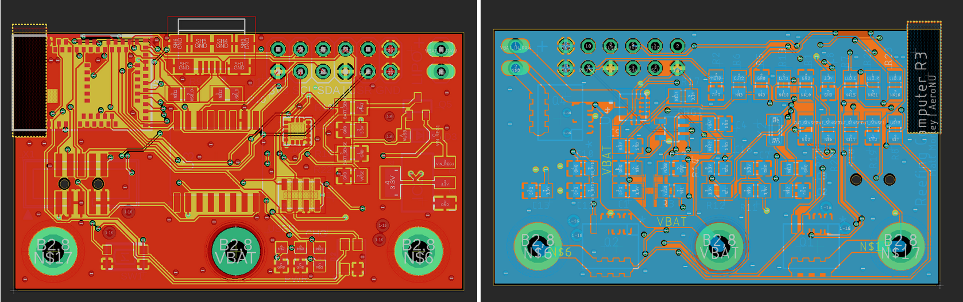
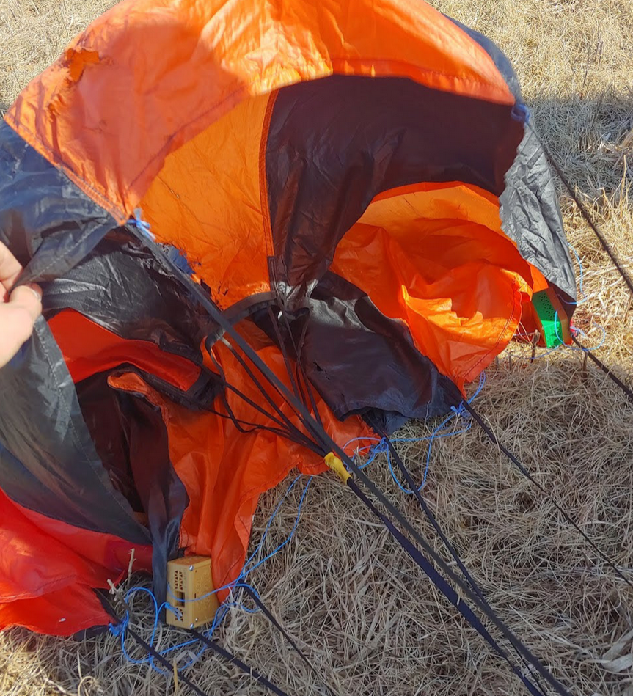
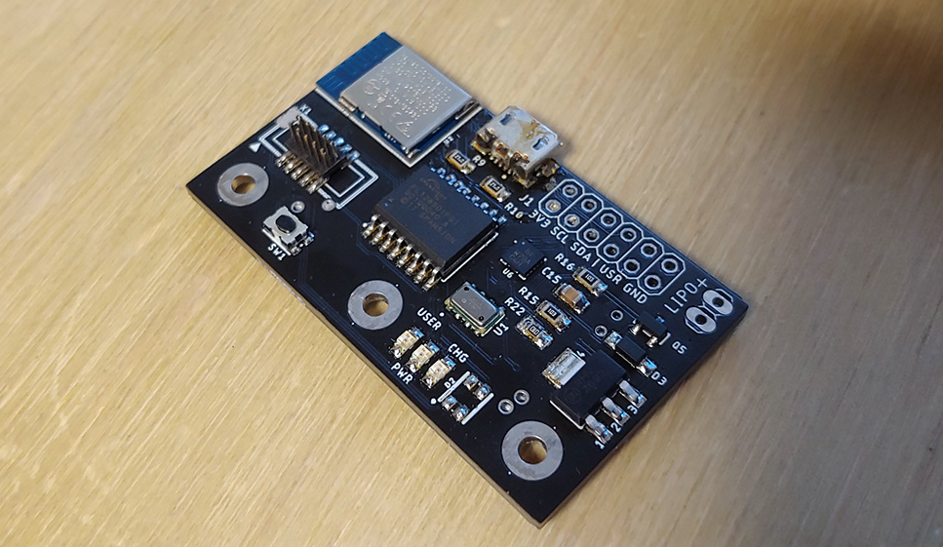
AerospaceNU - Line Cutter
Notes:
Let’s jump right into my first project with AerospaceNU, started fall of my Freshman year! (ongoing, multiple revisions)
Need: compact avionics solution to disreef (incrementally deploy) parachutes on our high-power model rockets
First time designing PCBAs, practicing surface mount soldering
Focus on embedded software, bootloader, working with peripherals
Also system-level design, balancing competing requirements (features vs size)

Slide 6
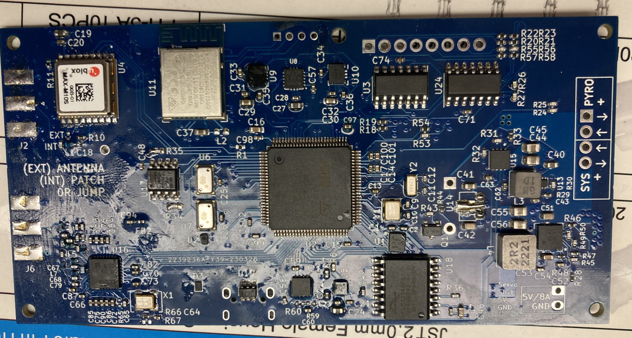
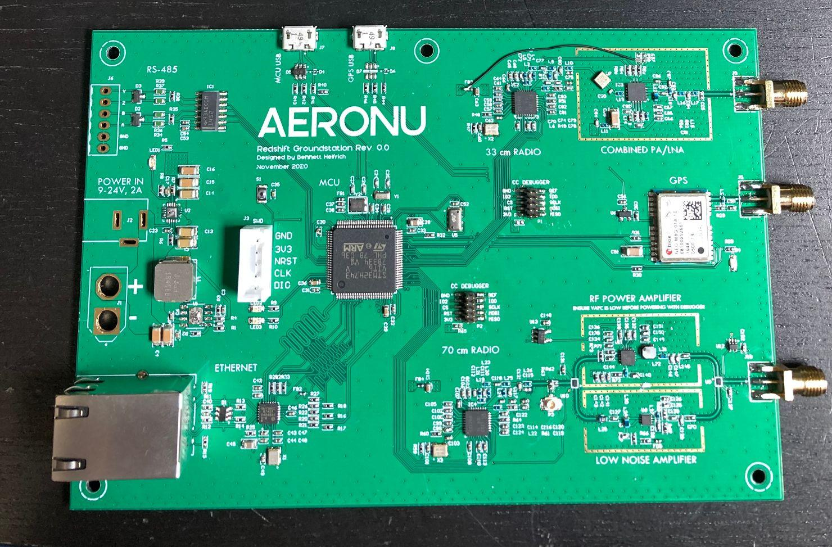

AerospaceNU - RF Telemetry
Need to telemeter critical rocket information
Location for recovery
Verify state on the pad
Initial prototype hardware design exists
Embedded software for radio hardware
Hardware revisions
Notes:
Let me set the stage a little more explicitly.
Lay out why we care
Set the stage
What did I work on?
Embedded software!
Drove hardware revisions as well

Slide 7
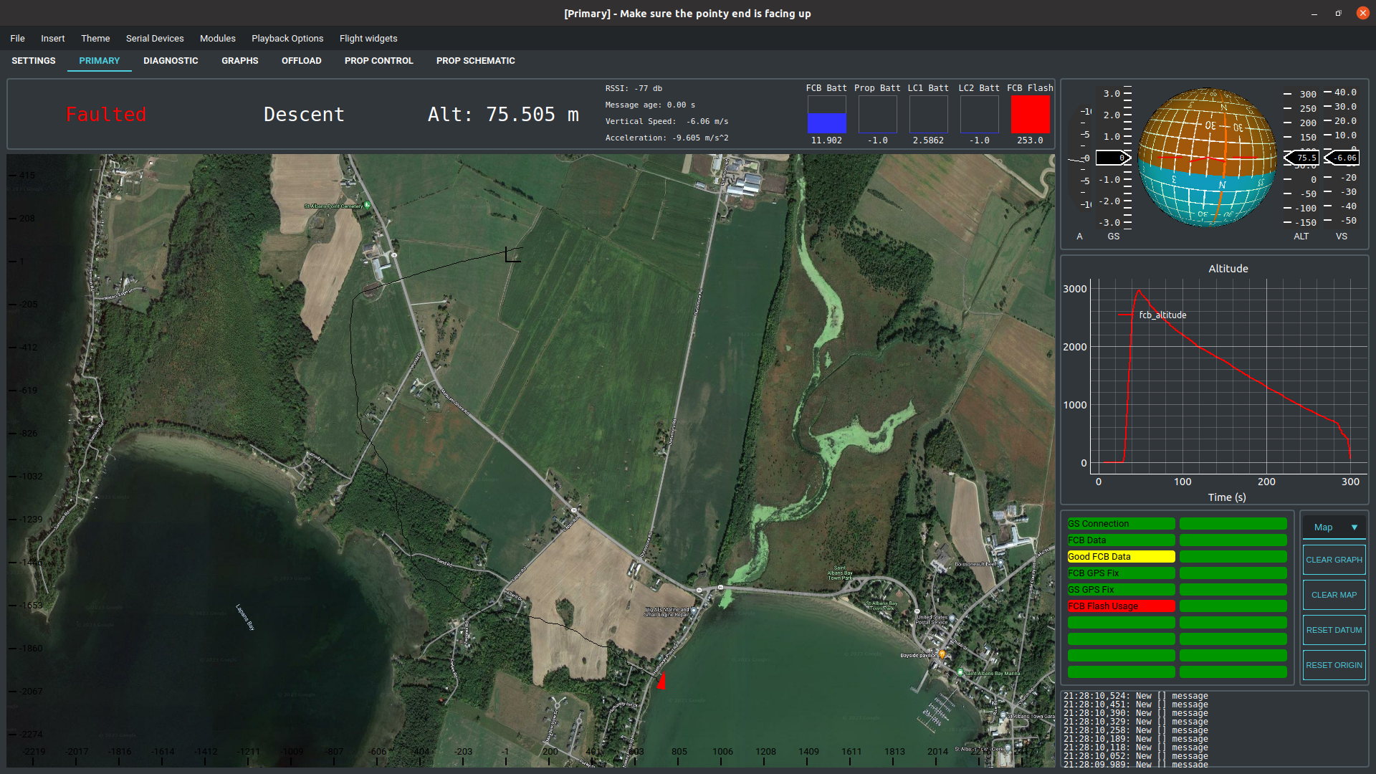
Project Scope
Hardware selection
Balance of size/layout/TX/RX
Link budget
Hardware design
RF layout
Register-level software
Eratta, hardware quirks
High-level behavior
TX/RX
Packet format
FSW Integration
Notes:
Project ran the gauntlet in terms of scope
Everything from systems engineering, to a little hardware layout, to register level embedded software, to higher-level behavior
At the end, we have a system that can robustly downlink data from rockets and also uplink commands if required

Slide 8
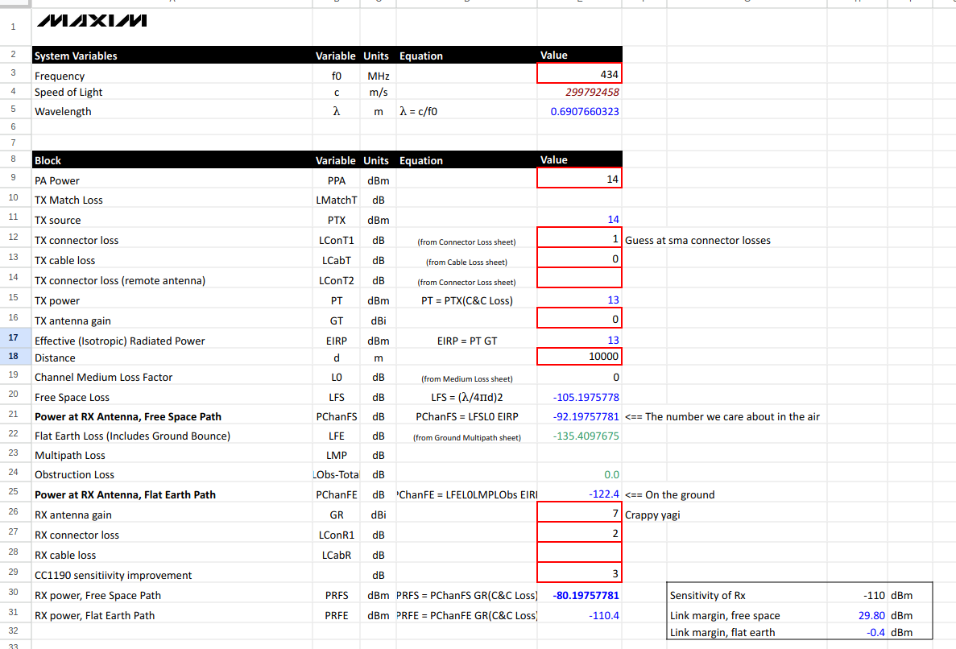
Hardware Context
Distance driven by DPF rocket specs
Link budget closes with no FE
RX Sensitivity ↔ data rate/modulation
Notes:
Hardware background for context

Slide 9
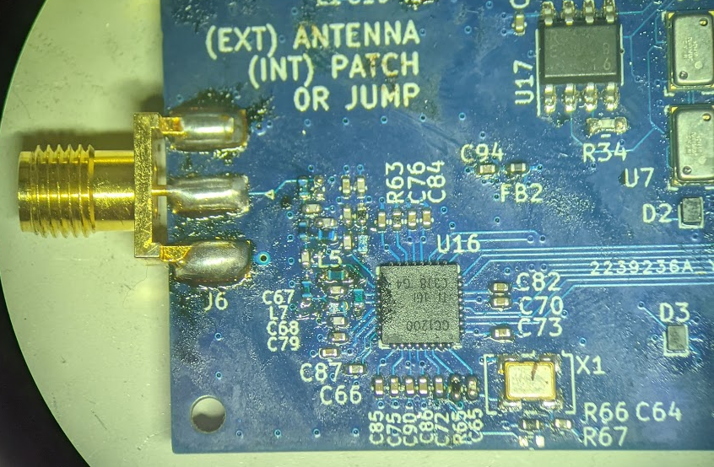
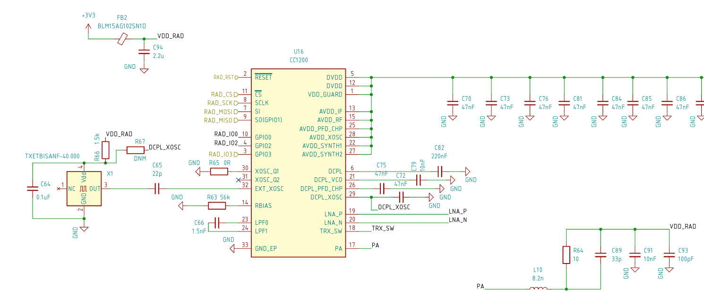
Hardware Context
TI CC1200
Single-chip packet radio
128 bytes max
FEC
Half-duplex
Notes:
Hardware background for context

Slide 10
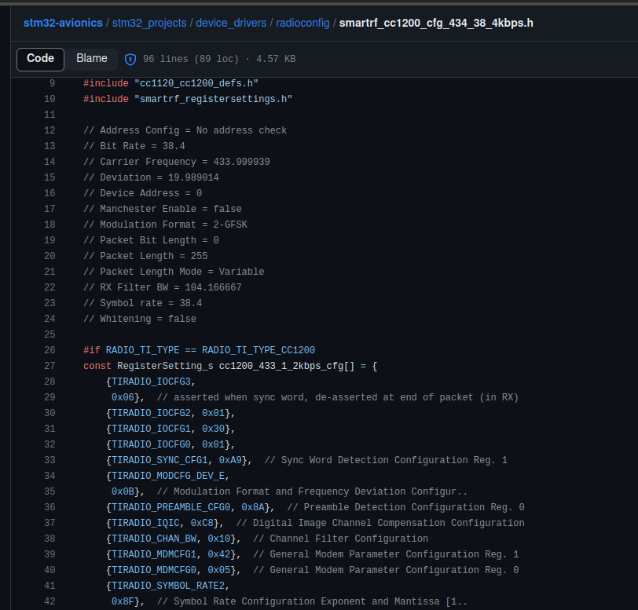
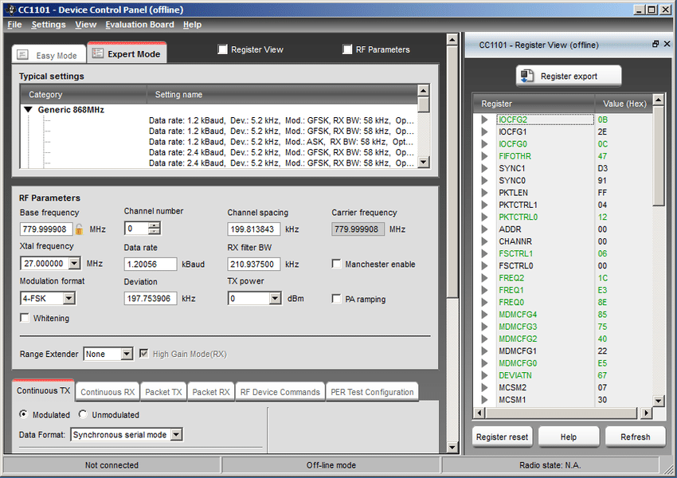
Register Configuration
Auto-generated register settings
Lots of magic numbers
Tweak settings from here
Selected modulation (right)
Notes:
Magic piece of software called SmartRF Studio
Generated (sometimes undocumented) register values to make the radio do what you want
Starting point for tweaking things like preamble detection, LBT

Slide 11
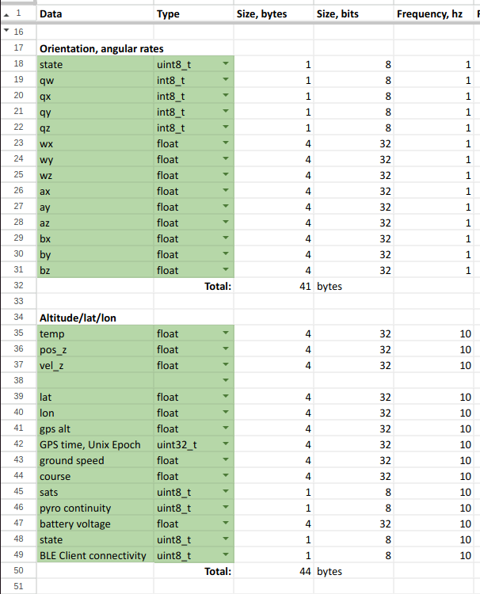
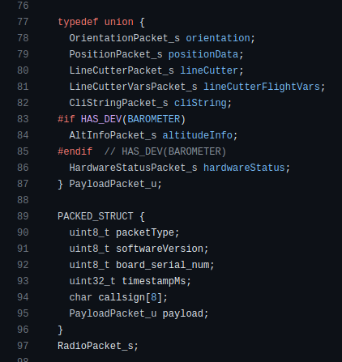
Packets!
Radio sends packets
Preamble, sync, data
Fixed size
Packet contents prioritized
Downlink important bits
C++ code to create & send
Notes:
Focus more on packet content

Slide 12
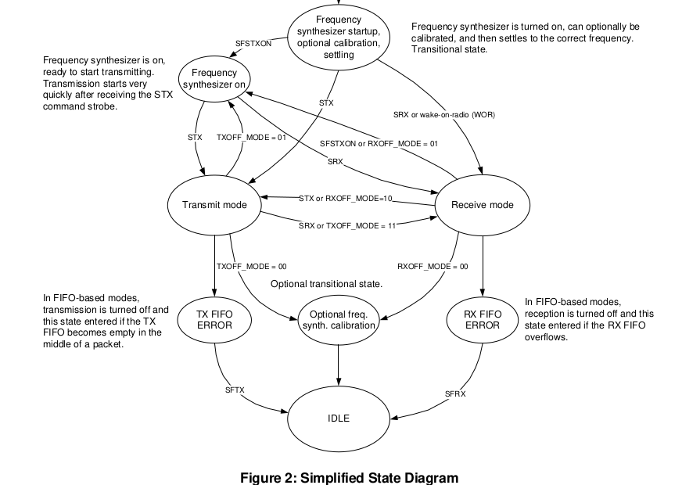
RF Access Control
Radio state machine
Radio defaults to RX when not actively in TX
Won’t interrupt RX for TX
High-level code enqueues
Most-overdue message
Buffered 10 deep internally
Radio driver has chance to start TX on tick
Rocket is independent of ground
No uplink guarantees

Slide 13
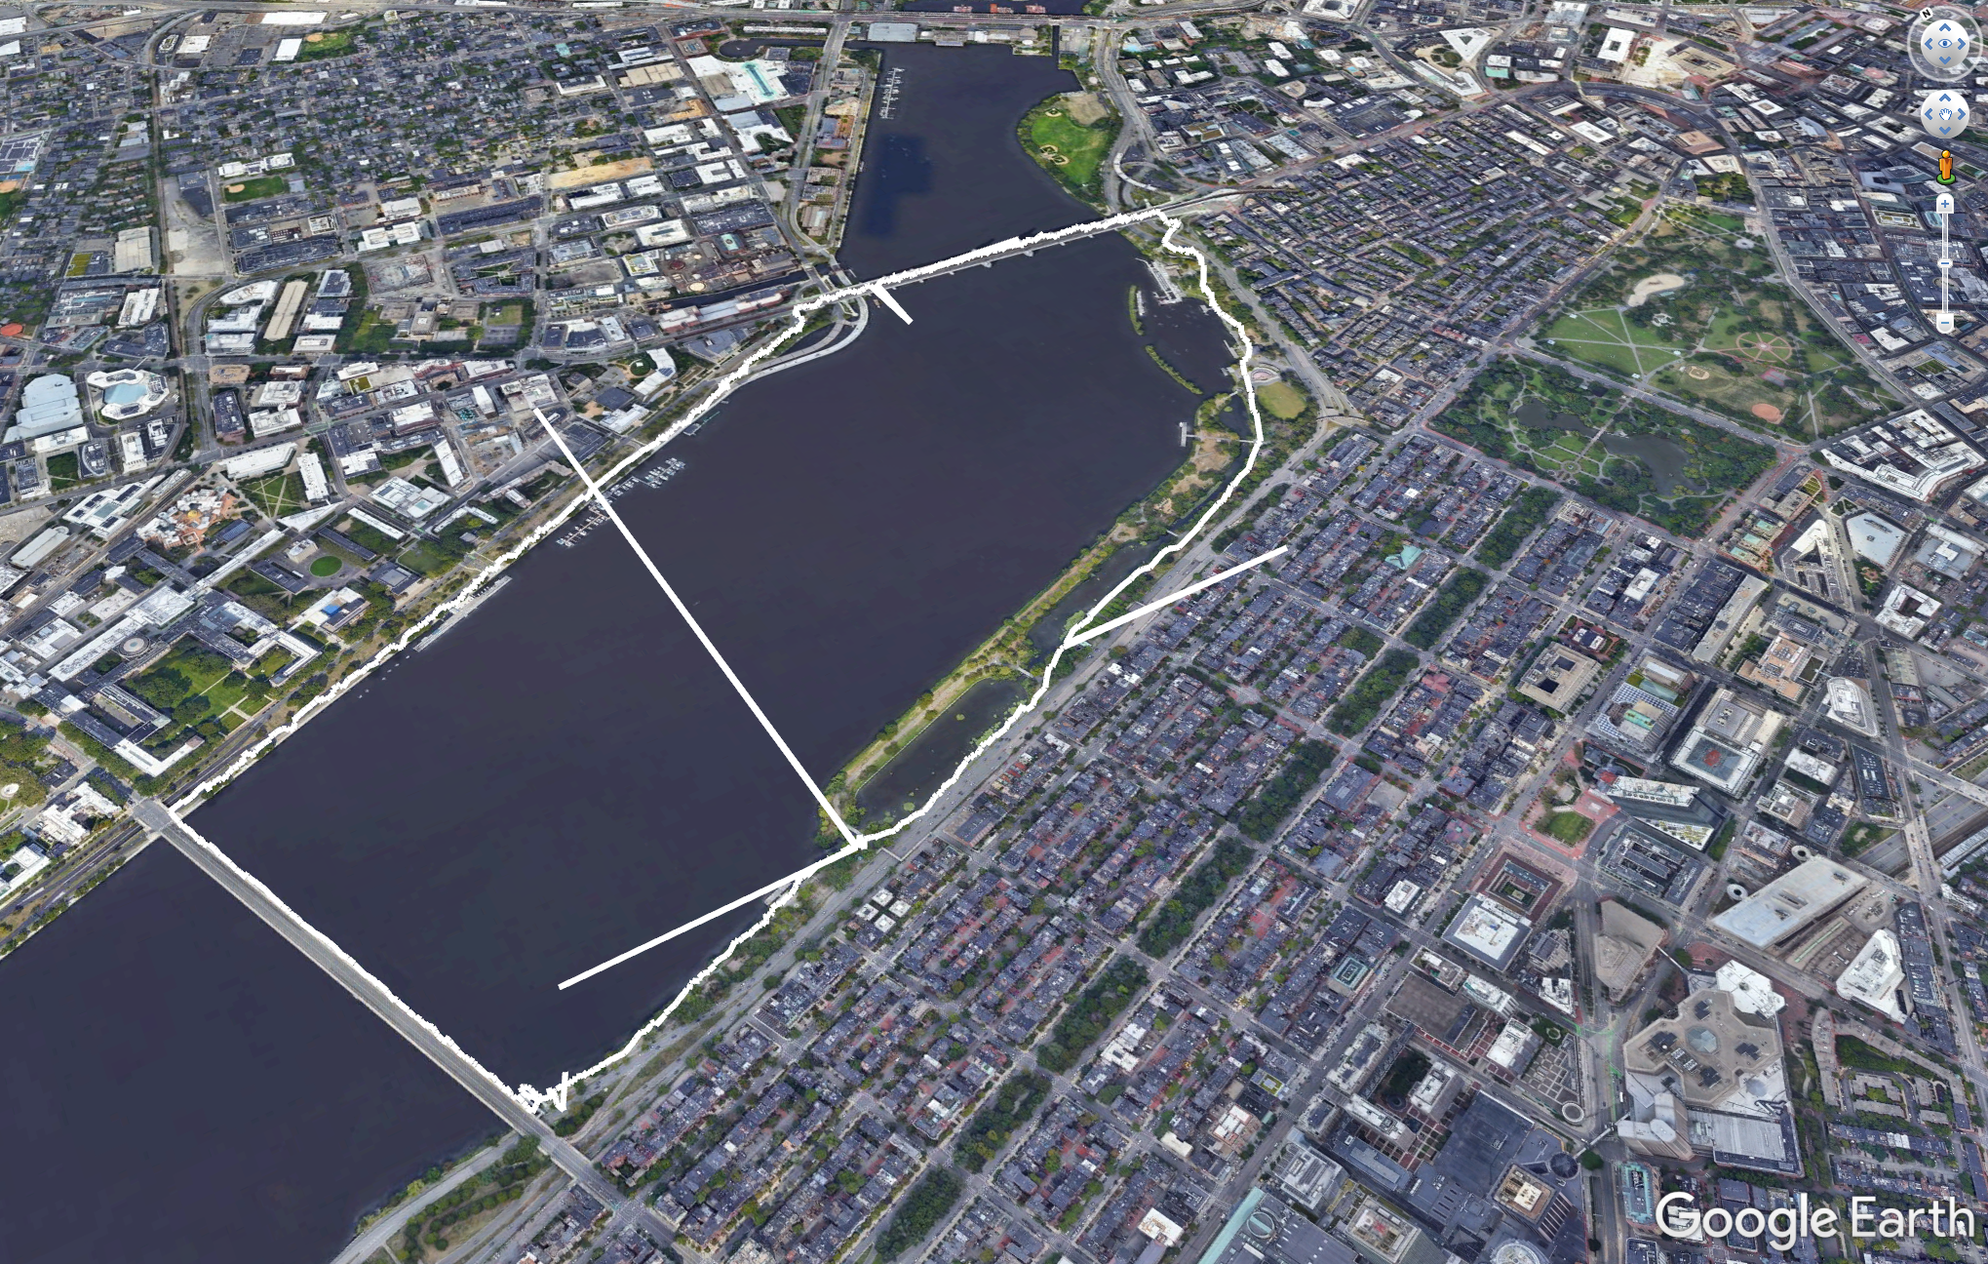
Charles River Radio Testing
Demonstrated 20hz telemetry
Single bit flip corrupting position
Floating point
No error correction
CRC filtering
Data integrity robustness
Software FEC
How do we uplink commands?

Slide 14
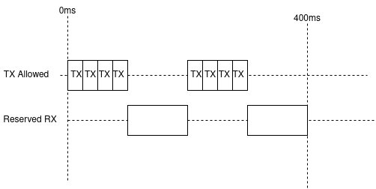
(Slightly) Improved Access Control
Requirement: stateless communication
Minimize required trust in link integrity
Simple software
Take advantage of radio state machine
Just don’t transmit half the time
Scrappy solution
Meets throughput requirements

Slide 15
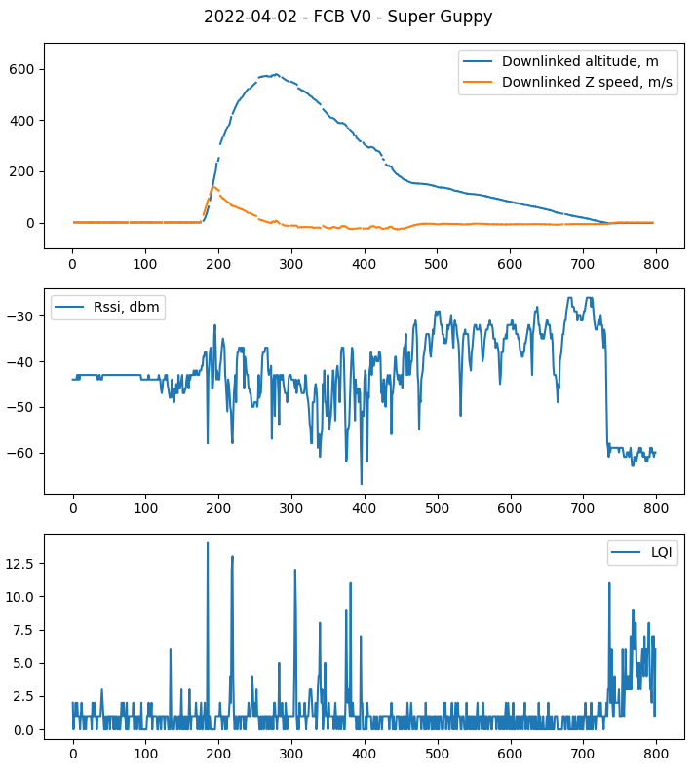
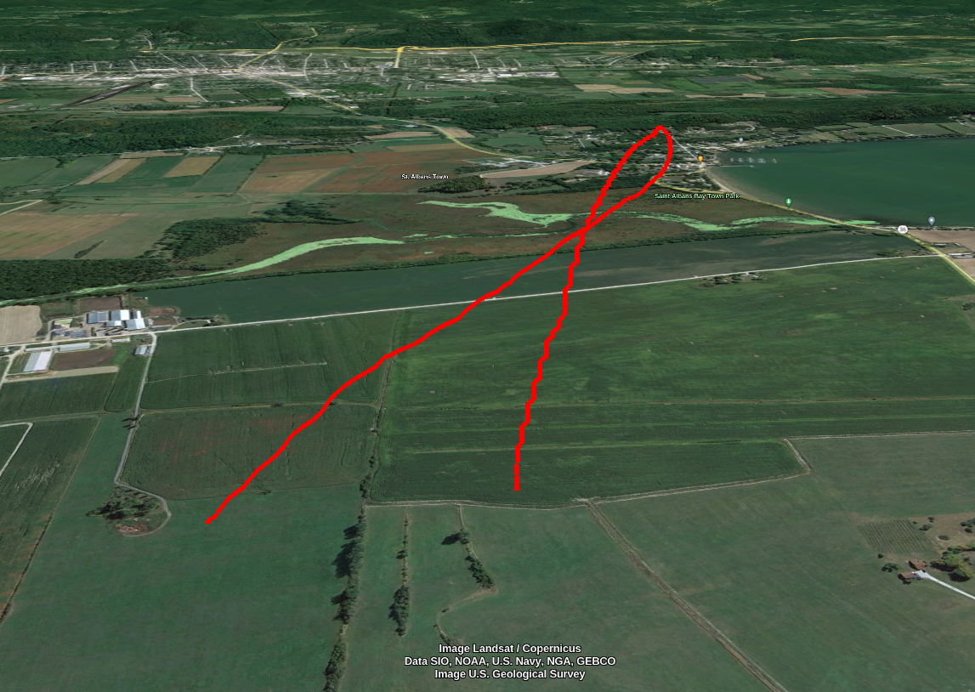
Flight testing!

Slide 16
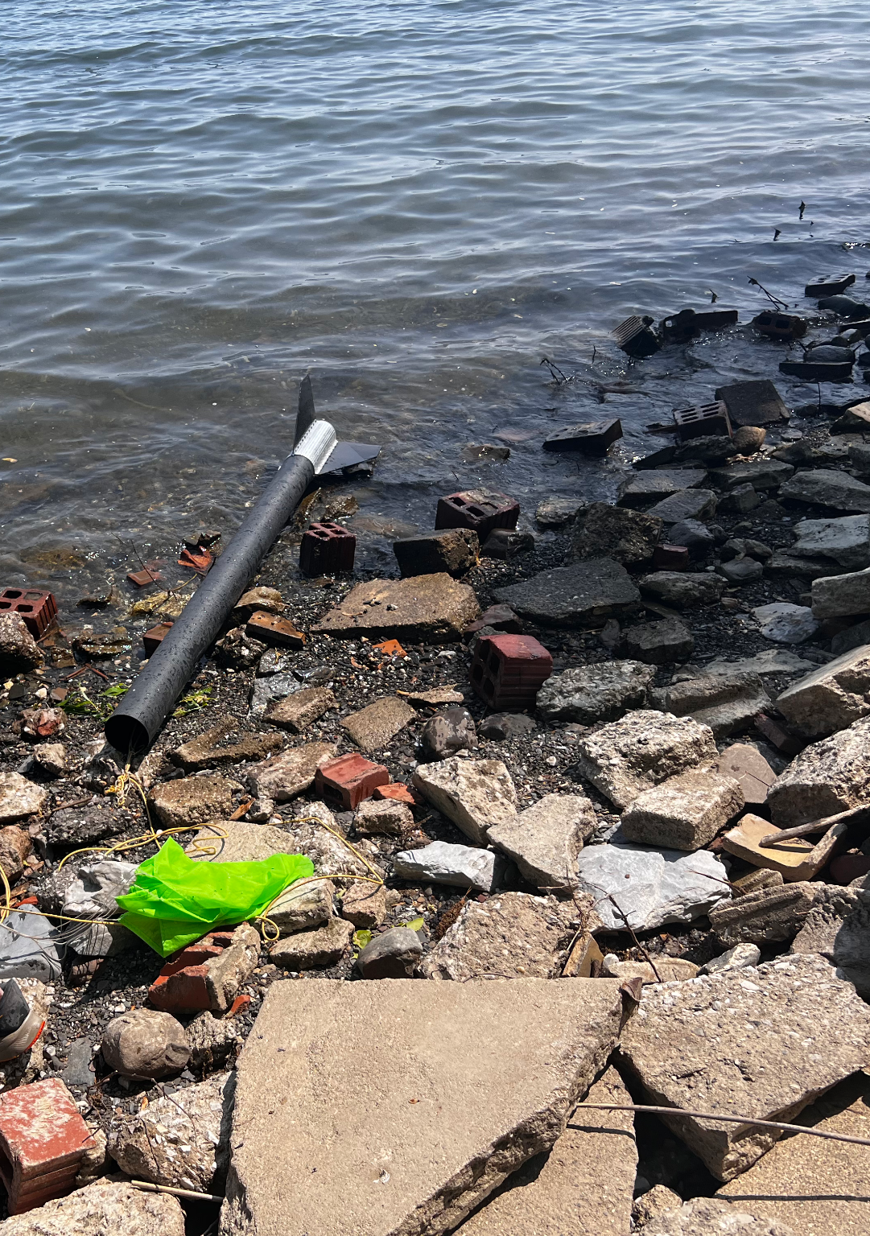
More flight data! (2023/05/07)
Notes:
Recent accidental stress test -- nearly 3km horizontal range, solid link up until ~200 meters above the ground
(Well, lake, really)
Hardware failure lead to early recovery devices deployment, drifted with the wind

Slide 17
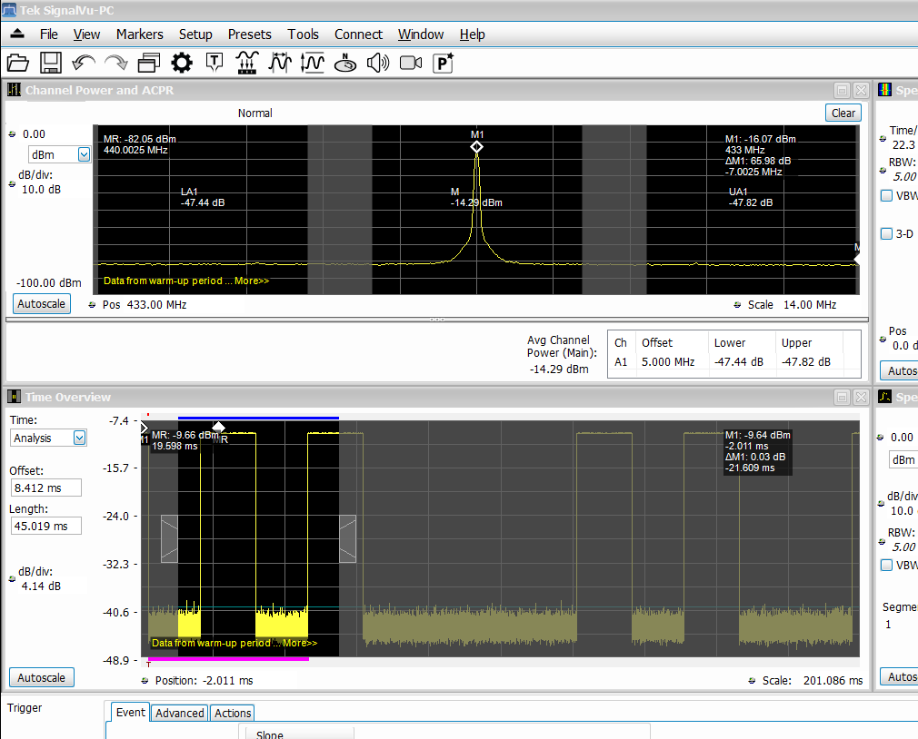
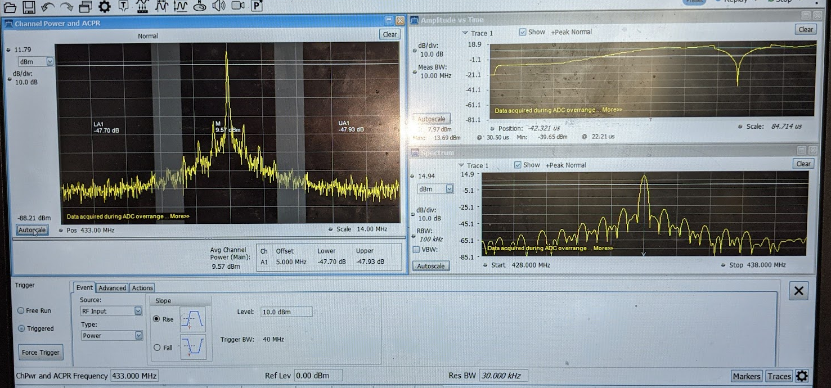
Other Anecdotes
RX FIFO overflow when uplinking commands
Puts radio into bad state
Can be detected and recovered from, if you know to look for and catch it
Hard to debug async hardware behavior
Low TX power from bad inductor

Slide 18
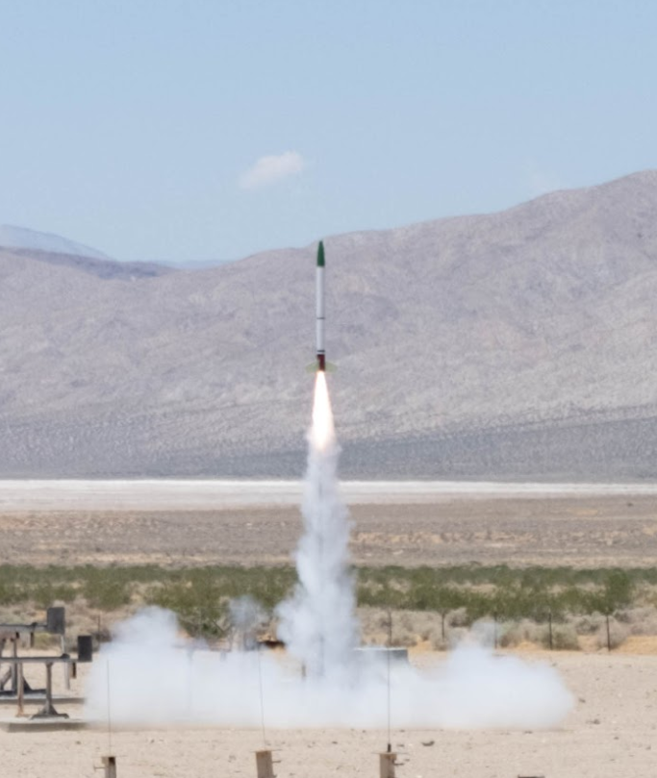
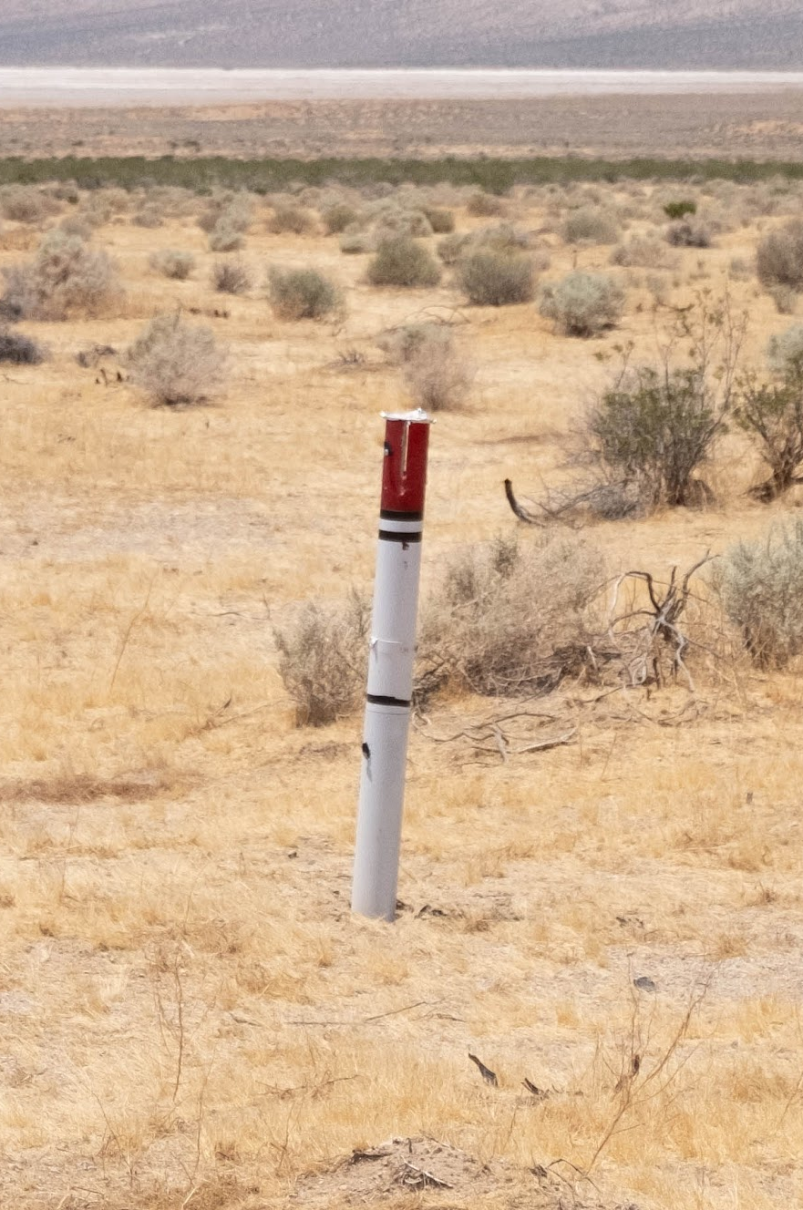
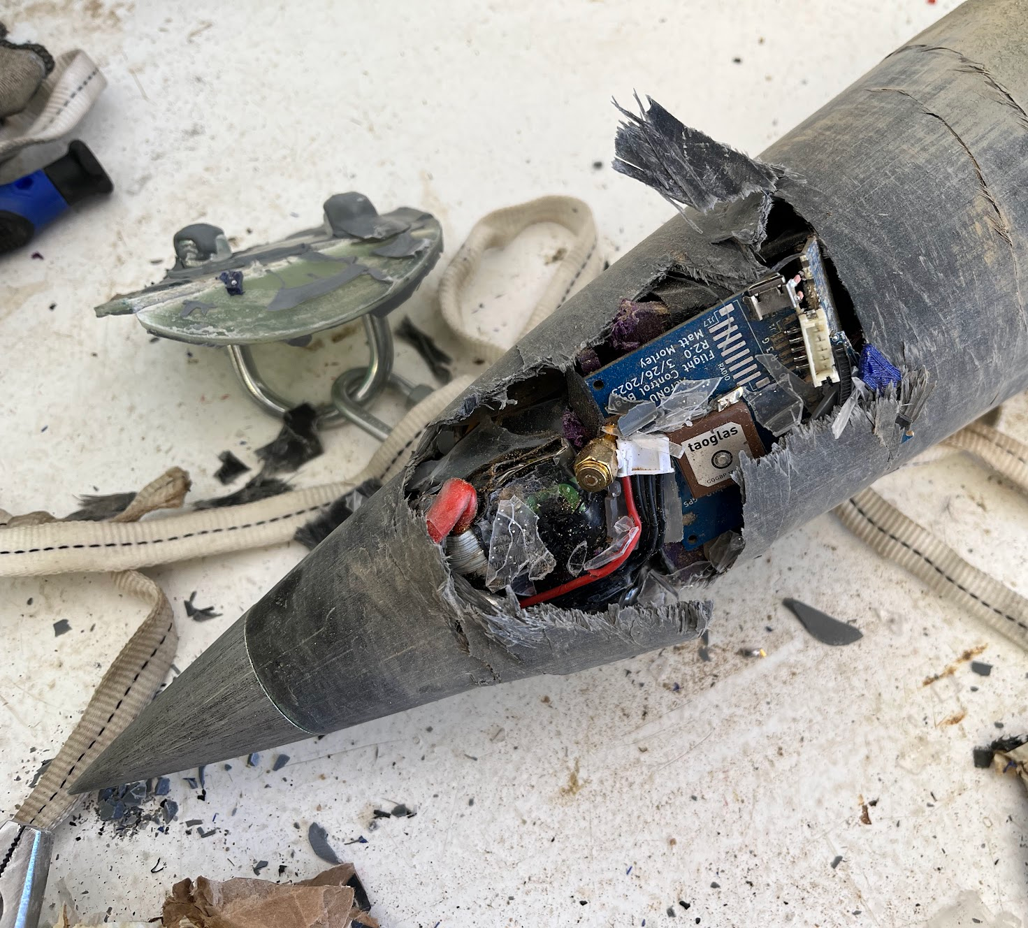
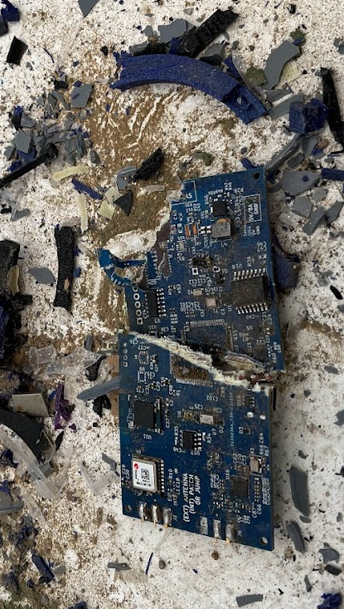
Unfortunately, Gravity
Notes:
Ending presentation on a slightly humorous note:
Recovery deployment failure on passive ride-along flight
Fantastic radio performance up until impact
Ballistic impact hard enough to rip fins off of body tube, extrude rocket through the nosecone

Slide 19
Why Blue?
Because reliable, sustainable access to space is critical
Because you’re actively developing the technologies to get us there
Because spaceflight is awesome

Slide 20
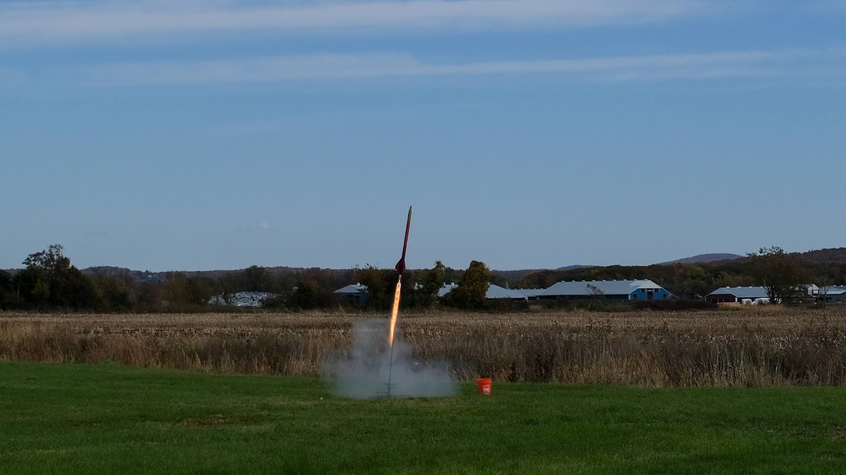
Thank you!
Notes:
J1799 flame cannot be beat, it’s awesome

